Slide 1
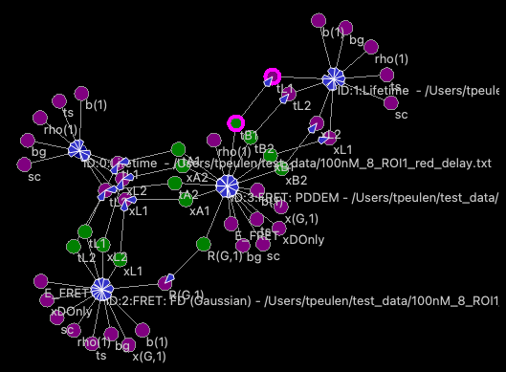

Slide 2
(1) Data loading
(2) Photon filter
(3) Data splitting
Micro time filter
(4) Correlation
(5) Selection
(6) Merging

Slide 3
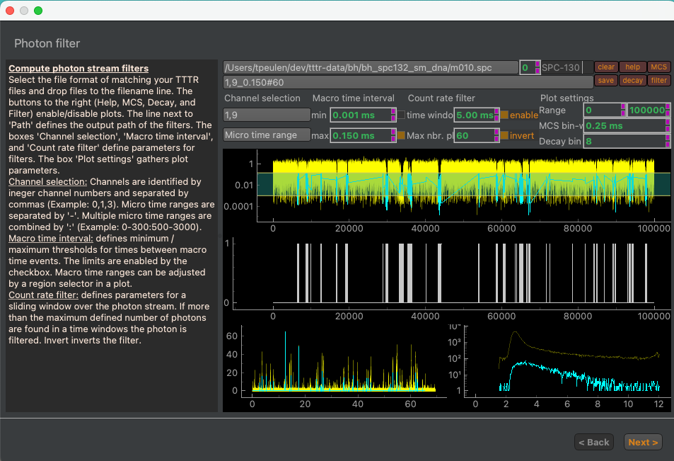
1
2a
2b
2c
a
b
c
d

Slide 4
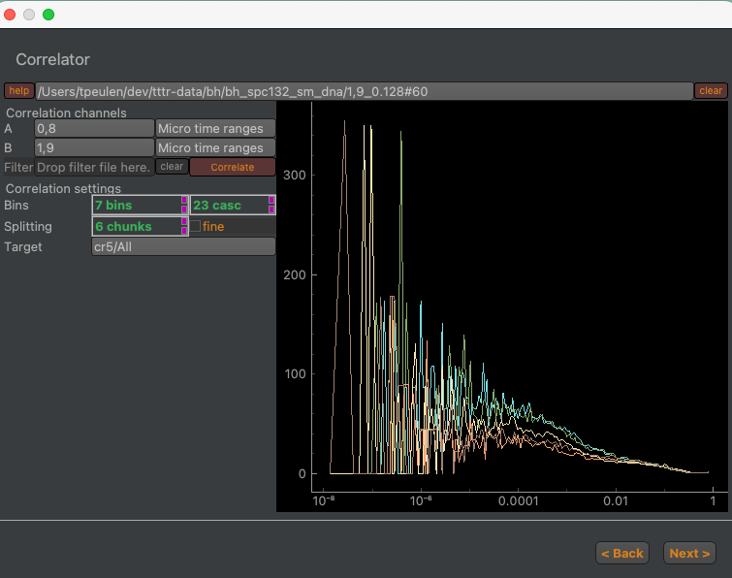

Slide 5
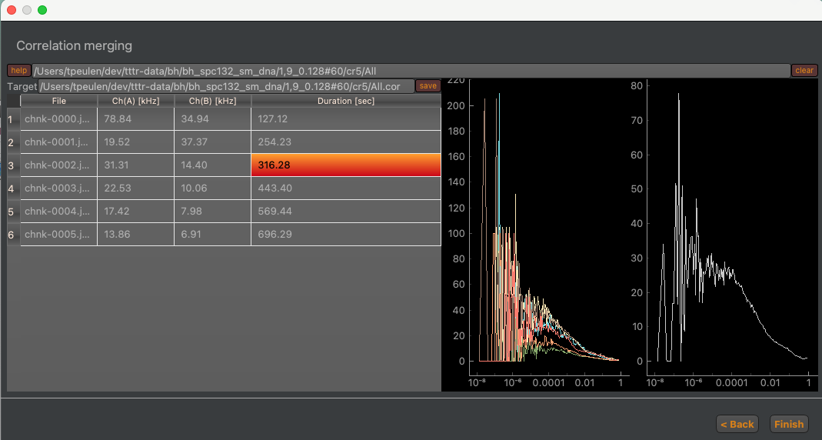

Slide 6
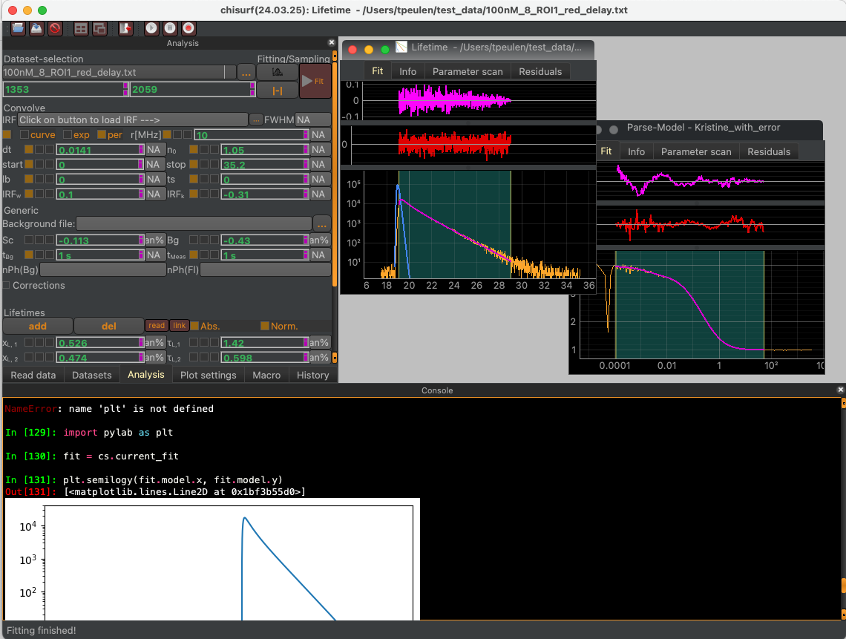
a
c
b

Slide 7
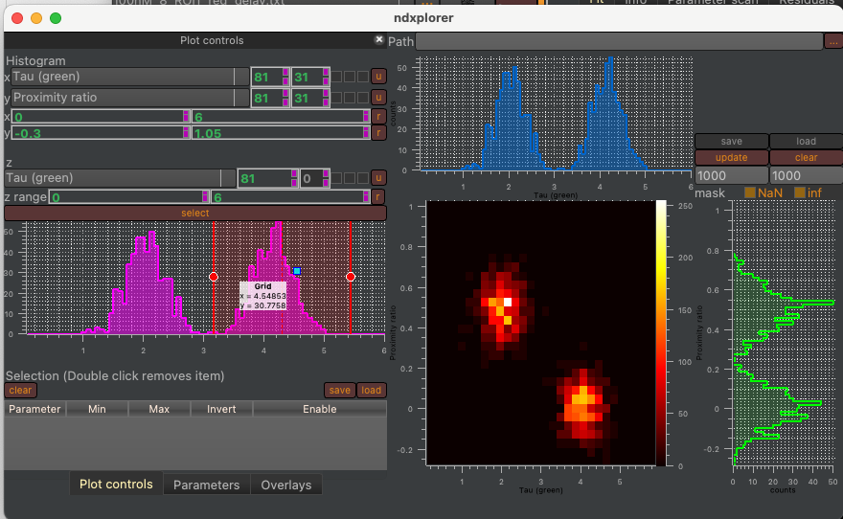
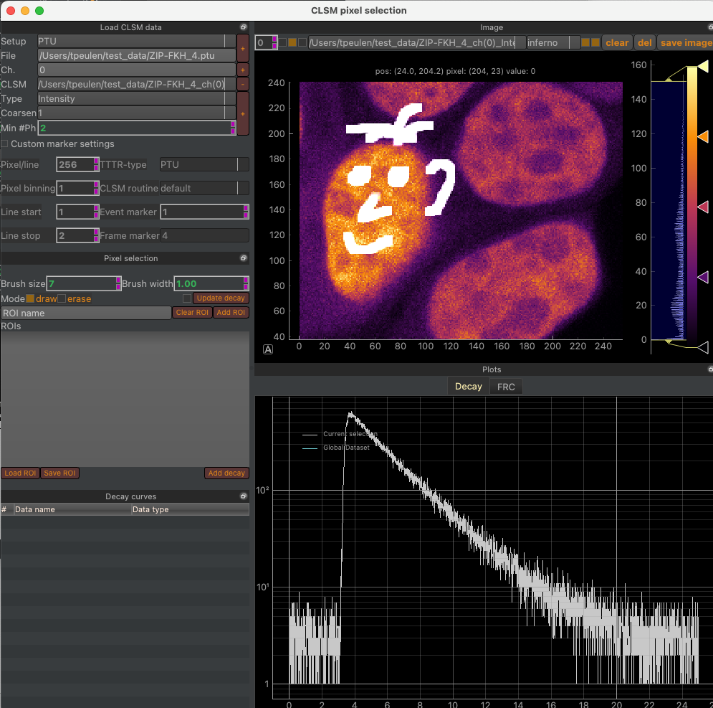
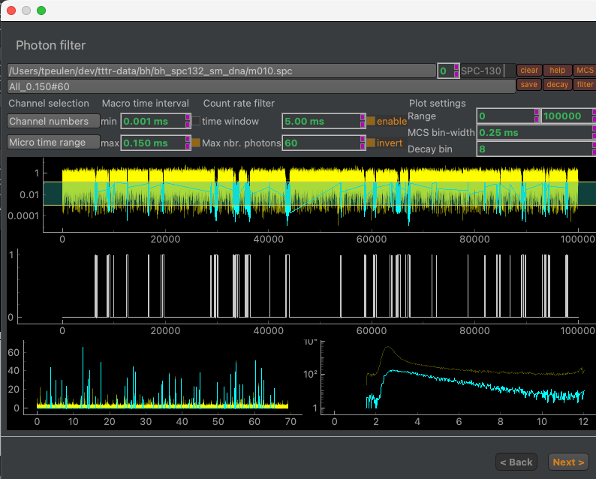
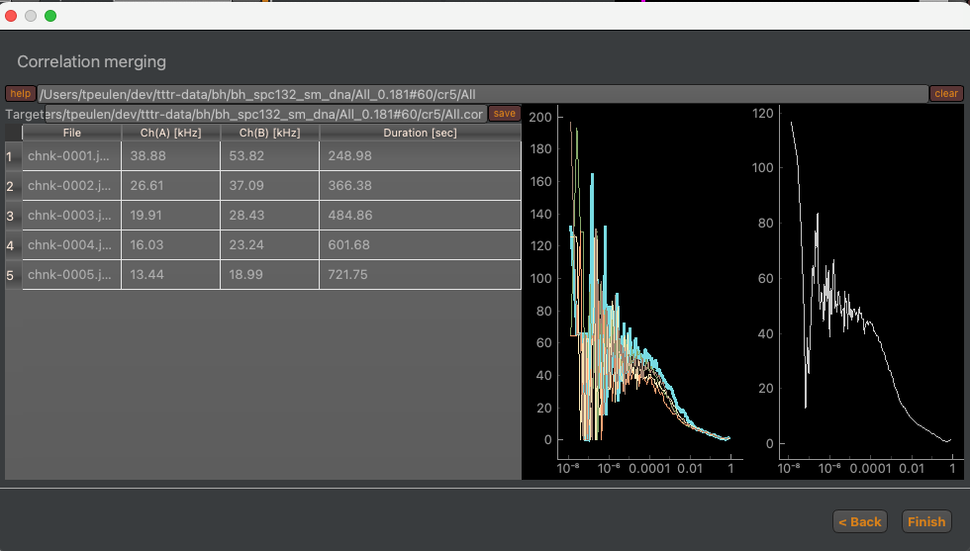
Burst-wise single molecule spectroscopy
Fluorescence Lifetime Image Microscopy
Fluorescence Correlation Spectroscopy

Slide 8
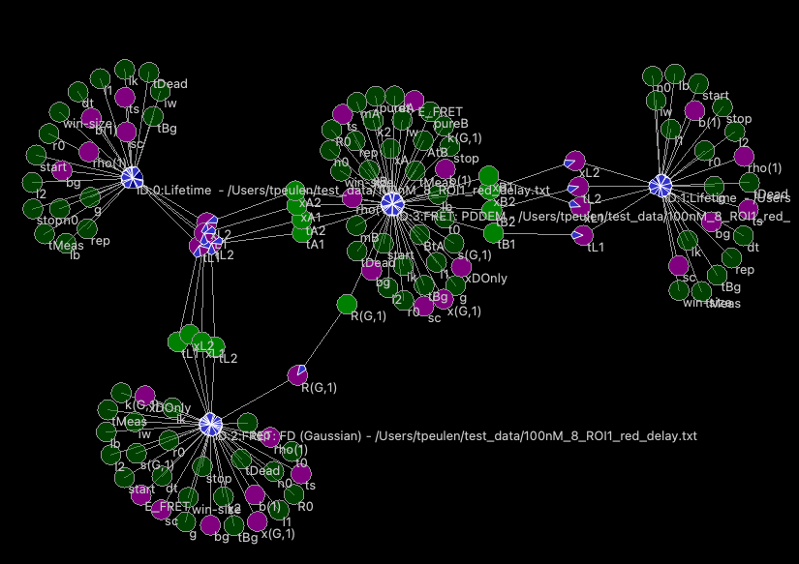
a
b
d
Parameter
Parameter
Parameter
Data
Model
Parameter
Parameter
Parameter
Fit
Parameter
Parameter
Parameter
Model
c
Fit 1
Fit 2
Global analysis
Parameter
e
Parameter
Parameter
Parameter
Parameter
…
Parameter
Parameter
Parameter
Parameter
Fit 1
Fit 2
Fit n

Slide 9
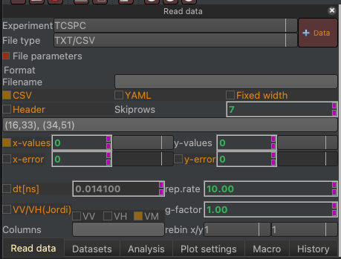
1
2
3

Slide 10
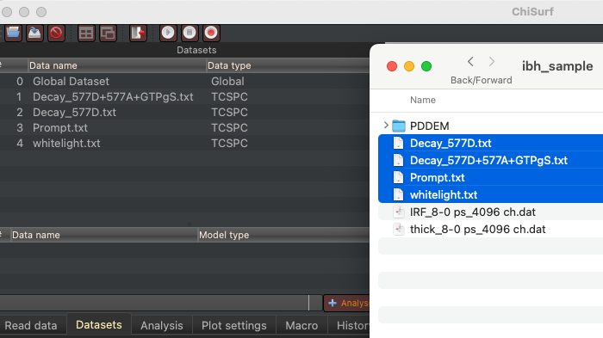
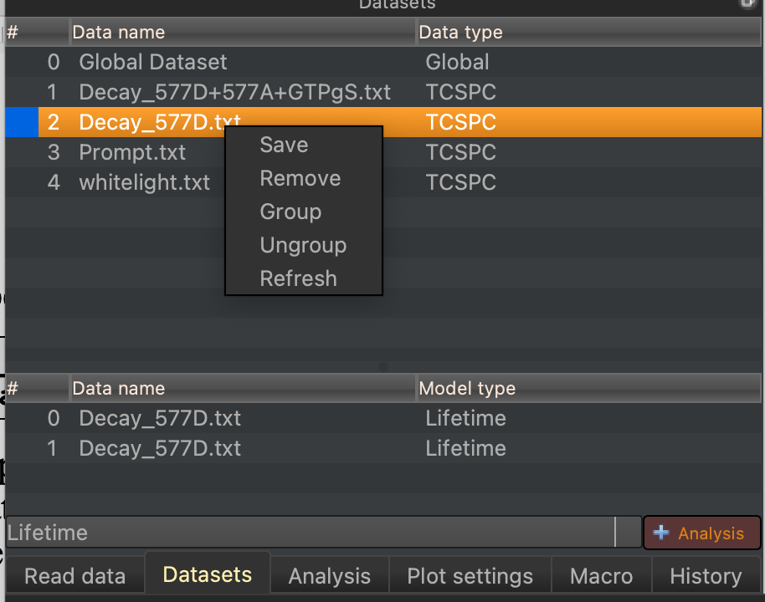
Drag and Drop

Slide 11
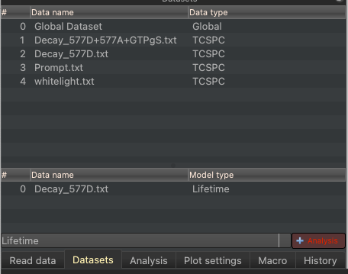
Data index
Create fit
1
Data list
Fit index
Fit list
2
3

Slide 12
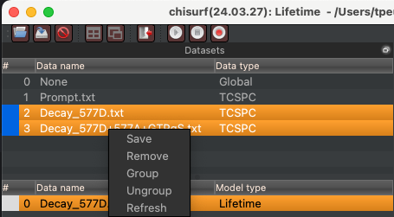
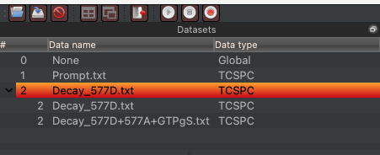
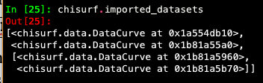
a
b
c

Slide 13
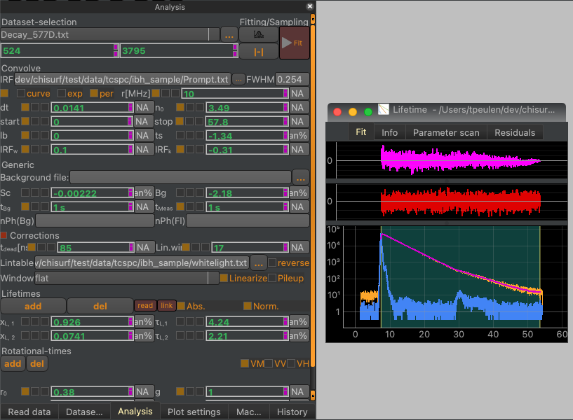
Fitting/sampling
Model parameters
Fit window
Multiple Document Interface
(MDI)

Slide 14

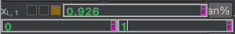
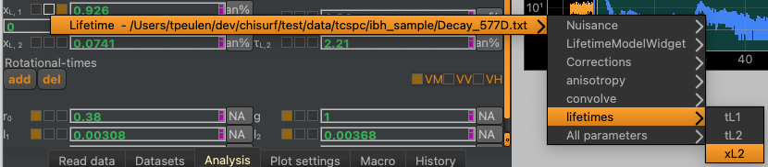
a
Fixing
Bounding
Uncertainty
b
Parameter name
Linking
Value
c

Slide 15
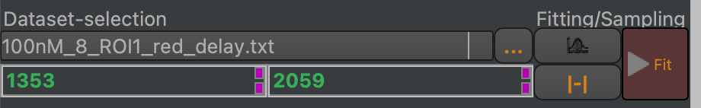
Dataset
replacement
Dataset selection
Sampling
Fitting
Scoring range
Auto range

Slide 16
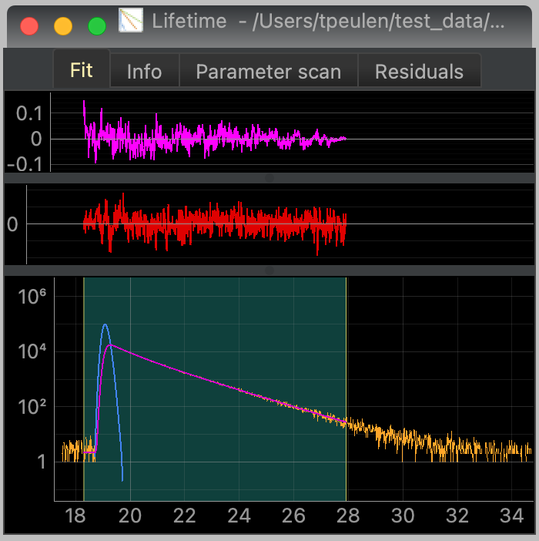
Scoring range
Scoring range

Slide 17
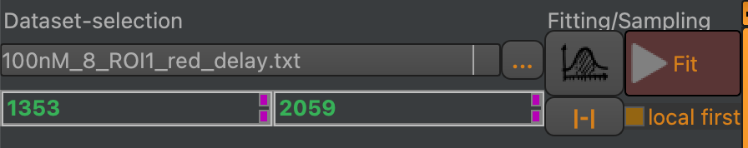
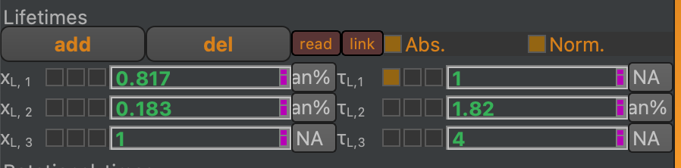
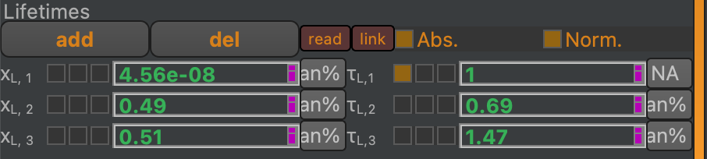
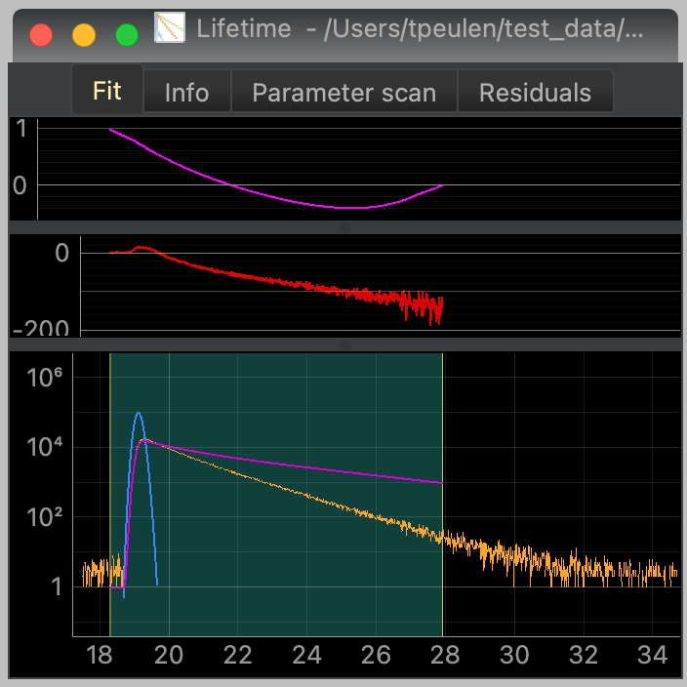
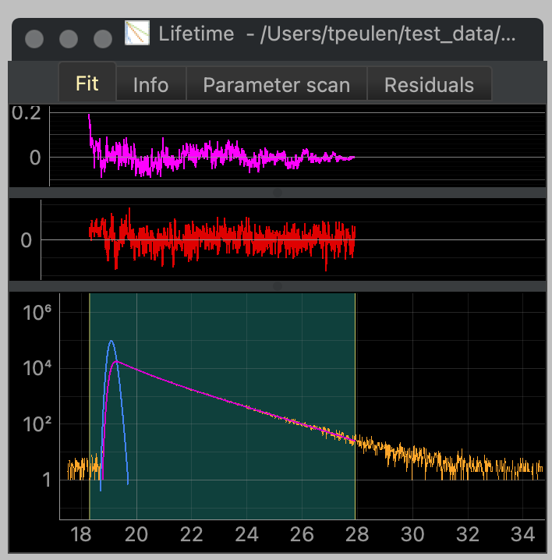
Fitting
Autocorrelation
Weighted residuals
Data
Model

Slide 18
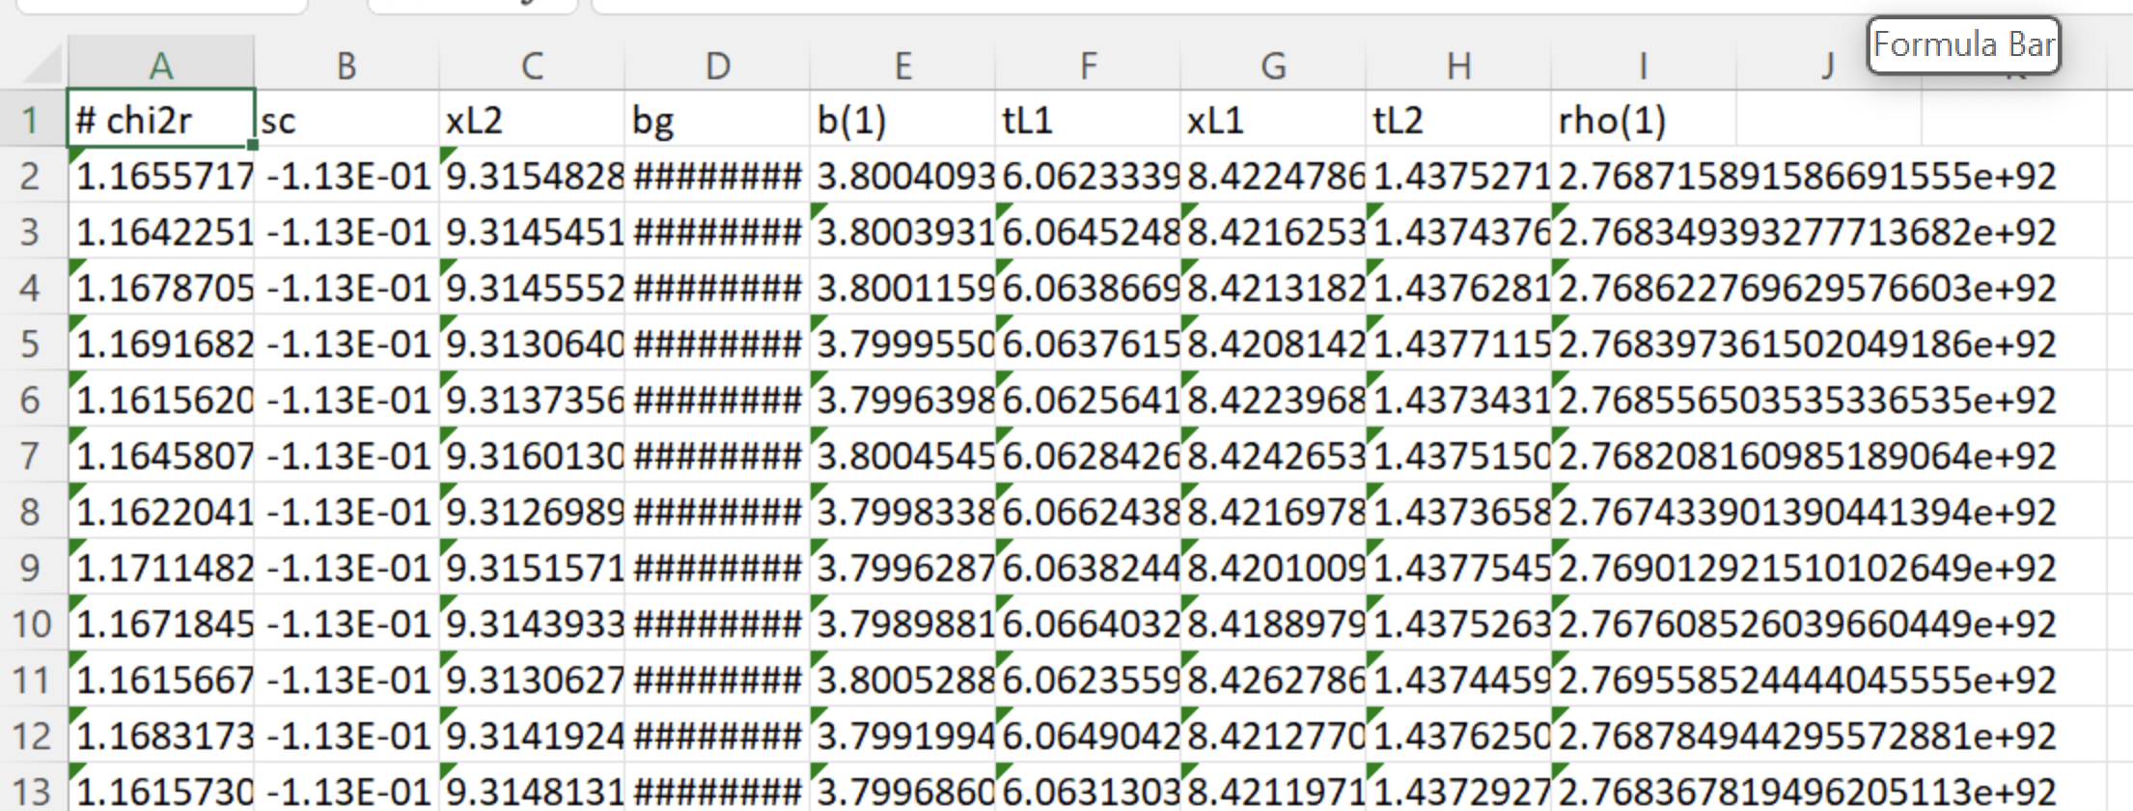
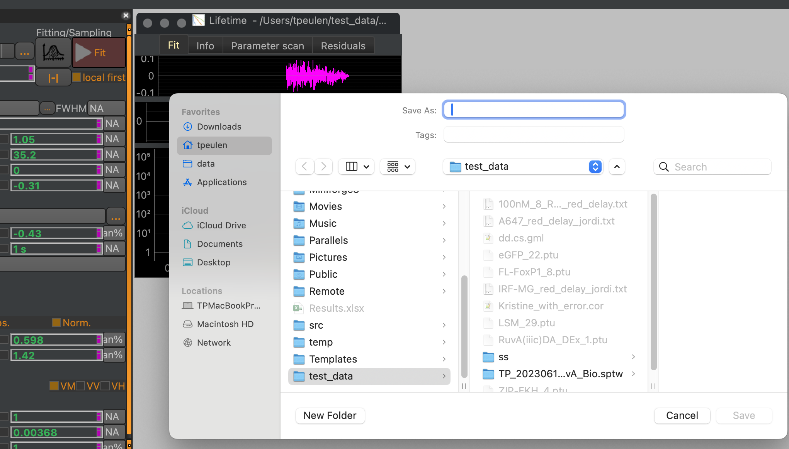
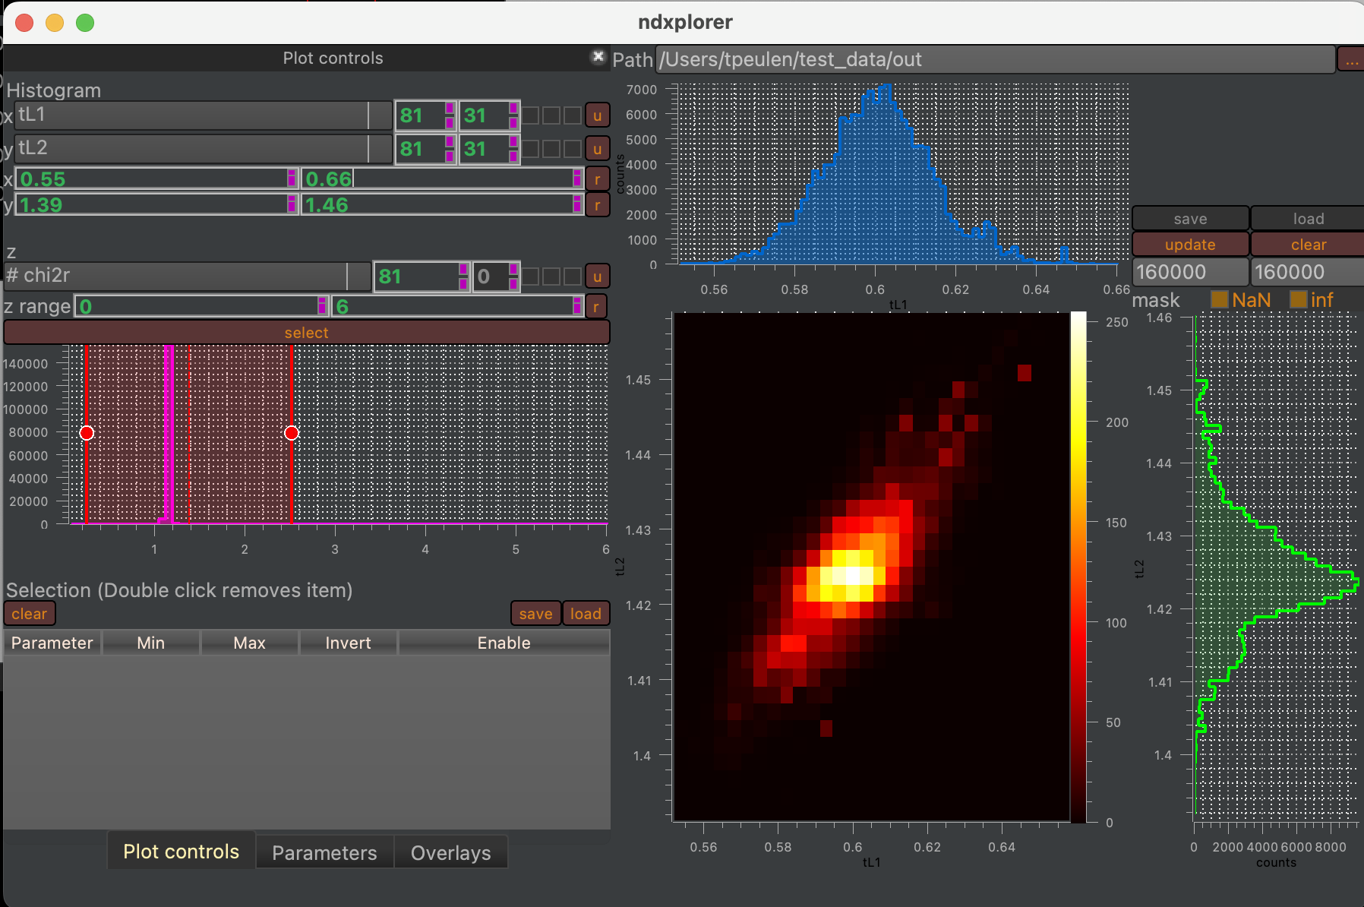
Sampling
Sampeled parameter values
Parameter distributions
Data
Model
Output folder selection
nDxplorer

Slide 19
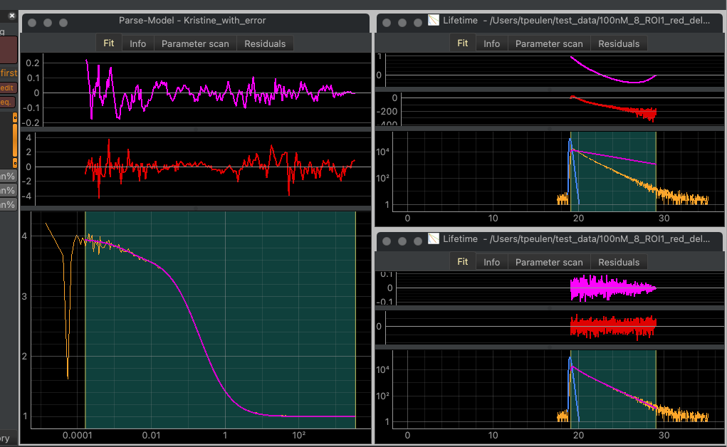
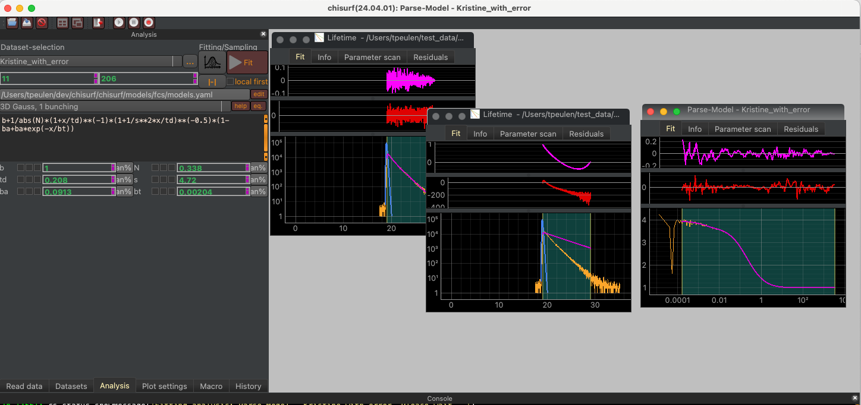
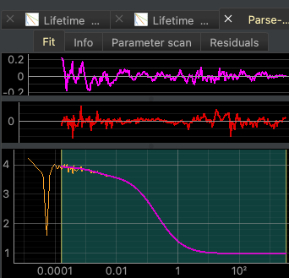
Tiled windows
Tile windows
Save fit
Stack windows
Macro tools
Fit 2
Open data
Close fit
Fit 3
Fit 1
Quit ChiSurf
Stacked windows
Fit 1
Fit 2
Fit 3
Fit 1
Fit 3
Fit 2
Multiple Document Interface (MDI)

Slide 20
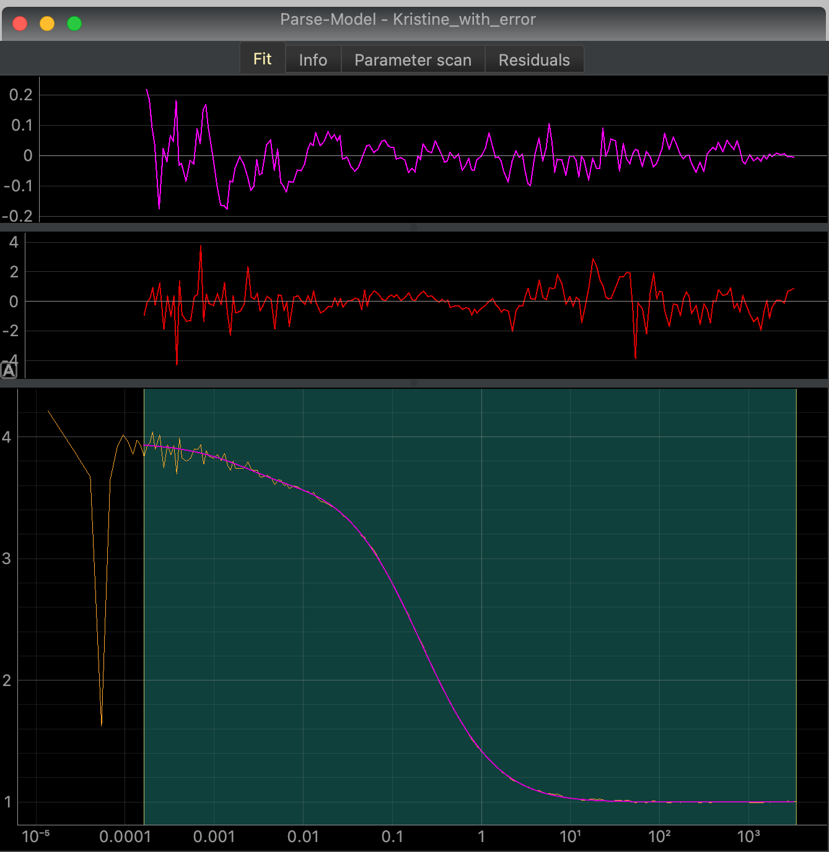
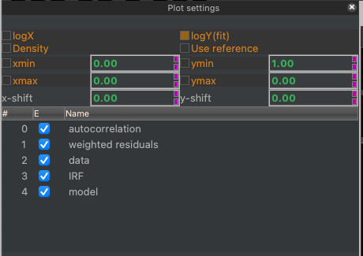
Plot selection
Plot settings

Slide 21
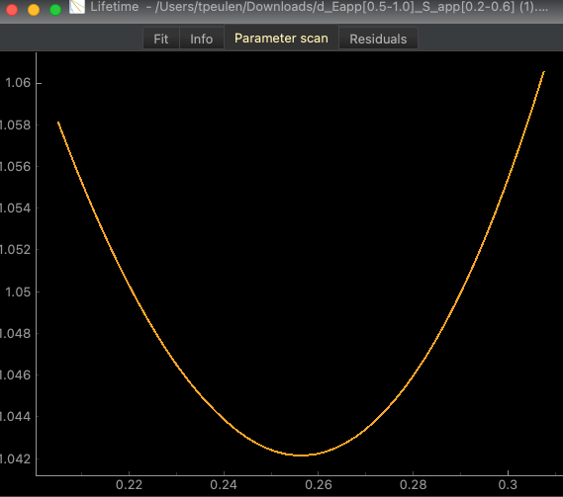
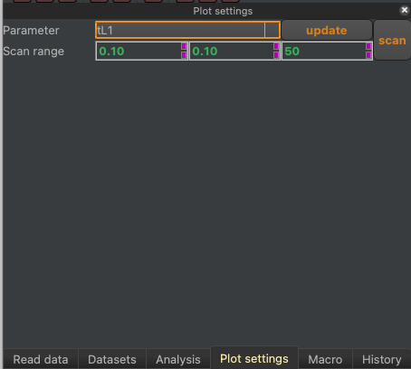

$$χ_{r}^{2}$$
Parameter value

Slide 22
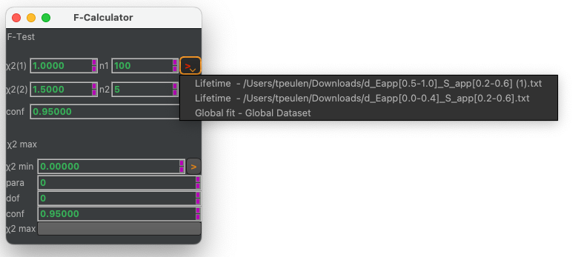
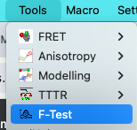
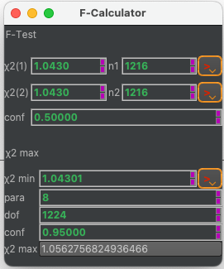
a
b
c

Slide 23
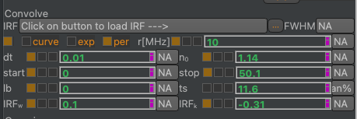
1
2
3
4
5
6
7
8
9
10
10
11
12
13
14

Slide 24
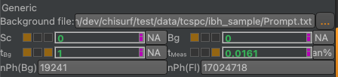
1
2
3
4
5
6
7
8
9
10
10
11
12
13
14

Slide 25
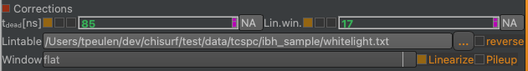
1
2
4
3
5
6

Slide 26
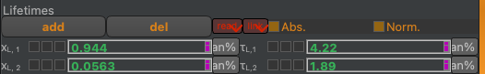
1
2
3
4
5
6
7
8
9
10
10
11
12
13
14

Slide 27
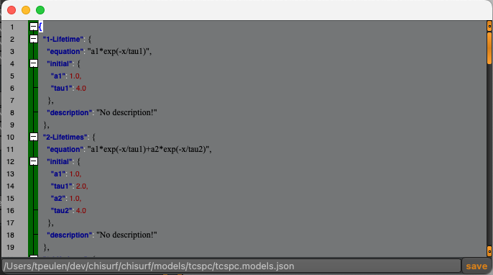
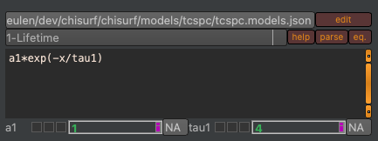
3
9
10
1
2
10
4
11
12
5
6
7
8
13
14
9

Slide 28
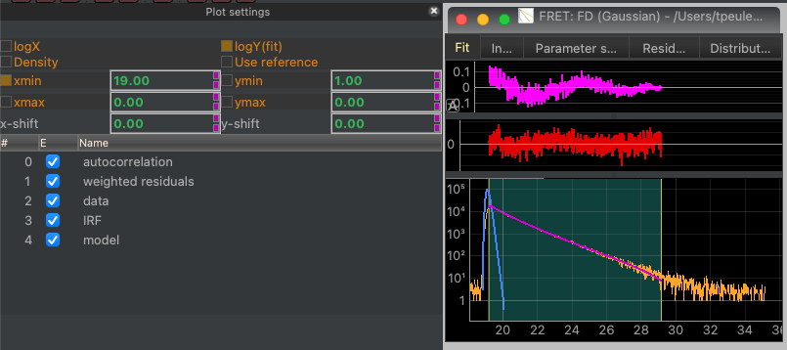
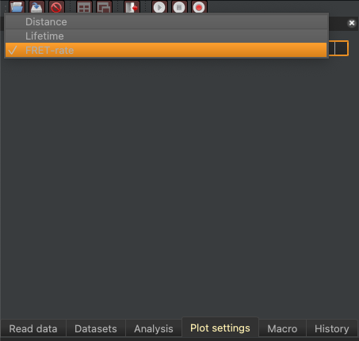
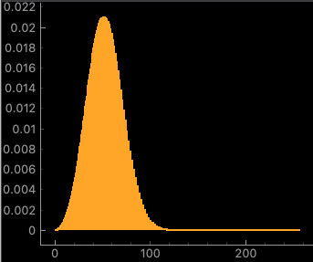
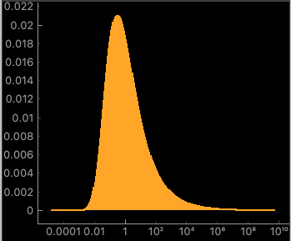









Fit plots of FRET models.
b
a
$$ACF(wres)$$
$$wres(f_{D|D}^{\left(DA\right)})$$
Distance
FRET rate
constants
$$f_{D|D}^{\left(DA\right)}$$
$$ACF(wres)$$
$$wres(f_{D|D}^{\left(DA\right)})$$
Fluorescence
lifetimes
(1 donor lifetime)
Fluorescence
lifetimes
(2 donor lifetimes)
$\frac{f_{D|D}^{\left(DA\right)}}{f_{D|D}^{\left(D0\right)}}$

